Slide 1
Adapter Design Pattern
The Adapter pattern translates an interface for an object or class into an interface compatible with a specific system.
This pattern is useful if an API is modified or new implementations are added to it.
In this case, if the other parts of a system are still using the old API, the adapter pattern will translate the interface such that the two can work together.
@ShankaragoudaG

Slide 2
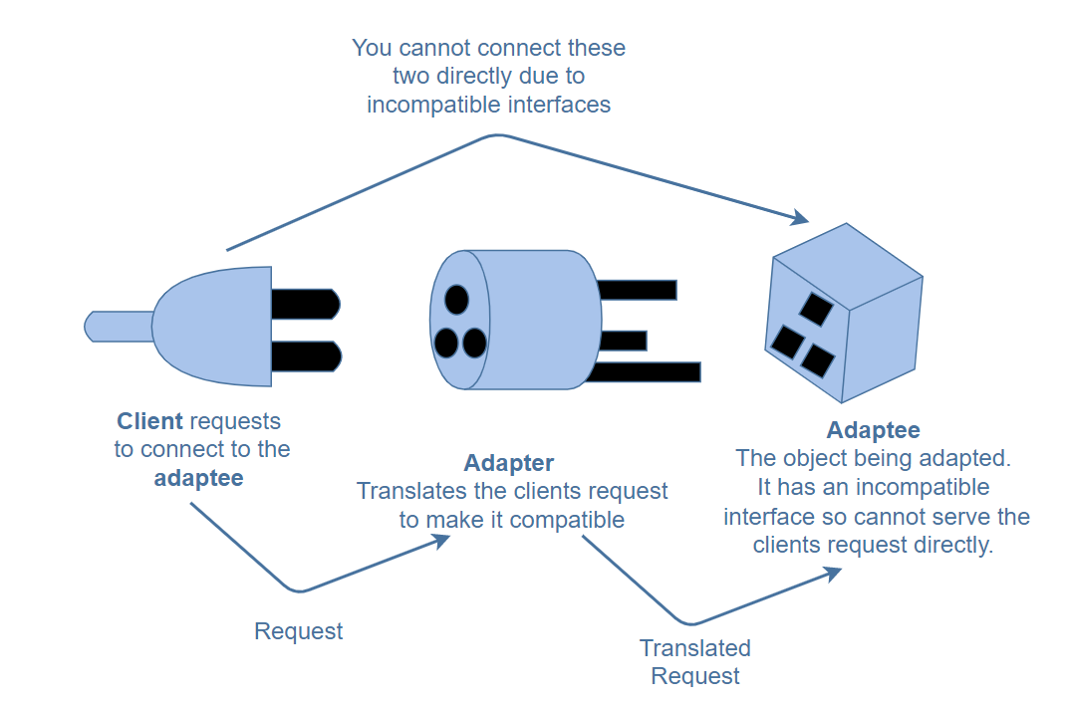
Adapter Design Pattern
The Adapter pattern is also referred to as the Wrapper Pattern.
The client cannot connect to the adaptee, directly as the two interfaces are incompatible. This is where the adapter comes in. It translates the clients’ calls to its interface and redirects them into calls to the adaptee (original interface).

Slide 3
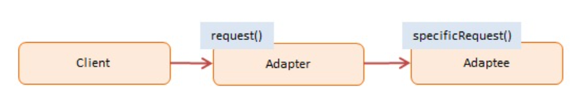
Diagram
Participants:
Client:
calls into Adapter to request a service
Adapter:
implements the interface that the client expects or knows
Adaptee:
the object being adapted
has a different interface from what the client expects or knows

Slide 4
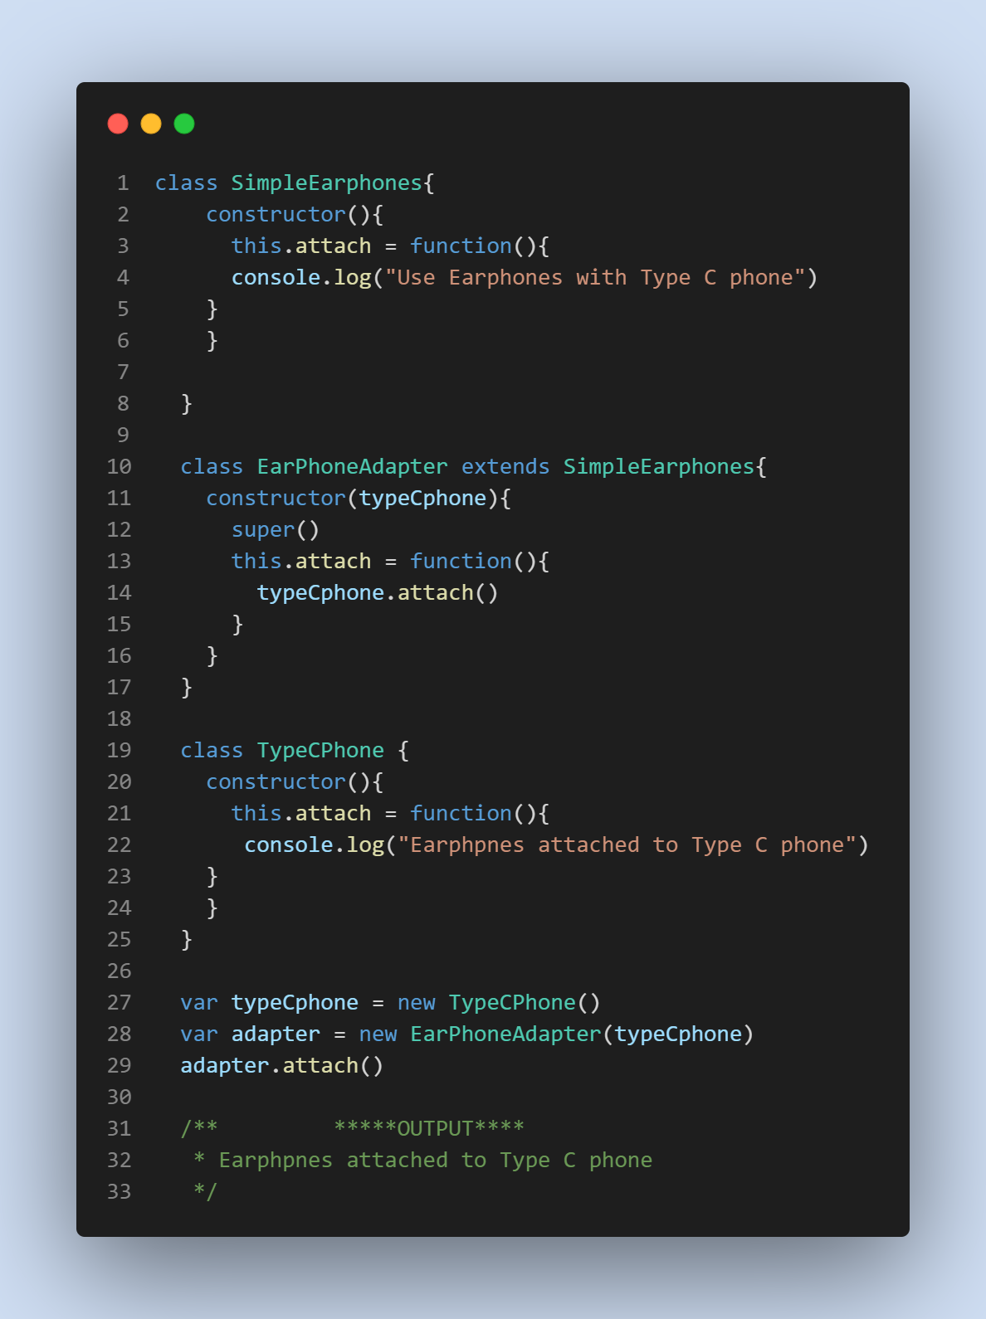
Example

Slide 5
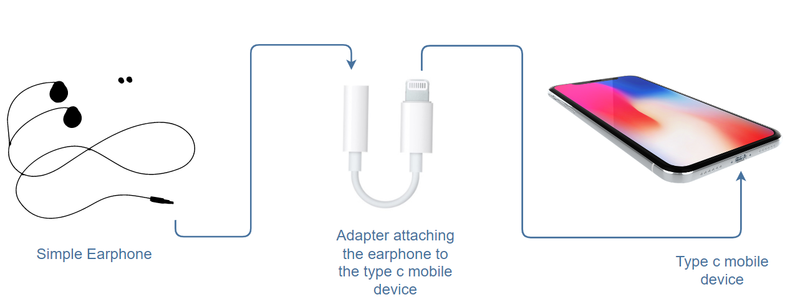
Continued...
axios-mock-adapter, which uses the Adapter pattern in its code to provide compatibility by supporting the use of promises and the original callback approach.

Slide 6
Useful Resources
https://www.educative.io/collection/page/5429798910296064/5725579815944192/5543883128700928
https://www.dofactory.com/javascript/design-patterns/adapter
https://www.patterns.dev/posts/classic-design-patterns/#wrapperpatternjquery

